Slide 1
Bank Account Simulation

Slide 2
INTRODUCTION :
This is a simple GUI based application which is very easy to understand and use. It uses Tkinter module for the GUI.
Talking about the application, the user can simply create their account and login in order to manage their bank accounts. It is directly connected to a database and handle automatically whatever actions you will perform. The Features of this Project are: Login/Register/Forgot Password ·Credit, debit, Transfer amount · Balance inquiry.

Slide 3
Looking for an online comprehensive solution to manage internet banking. This will be accessible to all customers who have a valid user id and password. This system provides the following facilities………
Balance
enquiry
Funds transfer to another account in the same bank
In India, a number of banks have either gone for Internet Banking or are on the verge of going for it. Bank Account Simulation I am talking about is different from what was possible up to now - off line information or few limited services. I am talking about the type that enables the customer to transact business on line in real time.
The Bank Account Simulation provides the facilities like Balance Enquiry , Funds transfer to another account in the bank .

Slide 4
In India, a number of banks have either gone for Internet Banking or are on the verge of going for it. Bank Account Simulation I am talking about is different from what was possible up to now - off line information or few limited services. I am talking about the type that enables the customer to transact business on line in real time.
The Bank Account Simulation provides the facilities like Balance Enquiry , Funds transfer to another account in the same bank, Request for cheque book .

Slide 5
. The Bank Account Simulation has developed a new security infrastructure for conducting commerce on the Internet. The initiative, called BankID, aims to become a national ID infrastructure supporting services such as authentication and digital signatures for the entire authentication population.
Many researchers expect rapid growth in customers using online banking products and services. The Bank Account Simulation allows customer contact through increased geographical reach and lower cost delivery channels. Customers can reach a given institution from literally anywhere in the world. Management must understand the risks associated with the Bank Account Simulation before they make a decision to develop a particular class of business.

Slide 6
System Analysis:
Purpose of the System:
This system provides an online solution to the customer by providing facilities such as balance enquiry, funds transfer to another account in the same bank etc.
Existing System:
Existing system is a manual system it will not provide the online system
Existing system does not provide the separate login for the user (customer).
Existing system does not provide the online transaction facility.
This system does not give the update account information for the customer

Slide 7
Proposed System:
The development of this new system contains the following activities.
Customer must have a valid user ID and password to login to the system
If a wrong password is given thrice in the session, that account will be locked and the customer will not be able to use it. When an invalid password is entered a warning is given to the user than the count going to get locked.
After the valid user logs in he is shown the list of accounts he has with the bank.
On selecting the desired account he is taken to a page which shows the present balance in that particular account number. User can view his monthly as well as annual statements. He can also take print out of the same.
User can transfer funds from his account to any other account with this bank.
If the transaction is successful a notification should appear to the customer, in case it is unsuccessful, a proper message should be given to the customer as to why it failed.

Slide 8
Feasibility Study:
TECHNICAL FEASIBILITY:
Evaluating the technical feasibility is the trickiest part of a feasibility study. This is because, at this point in time, not too many detailed design of the system, making it difficult to access issues like performance, costs on (on account of the kind of technology to be deployed) etc. A number of issues have to be considered while doing a technical
analysis.
Understand the different technologies involved in the proposed system:
Before commencing the project, we have to be very clear about what are the technologies that are to be required for the development of the new system.

Slide 9
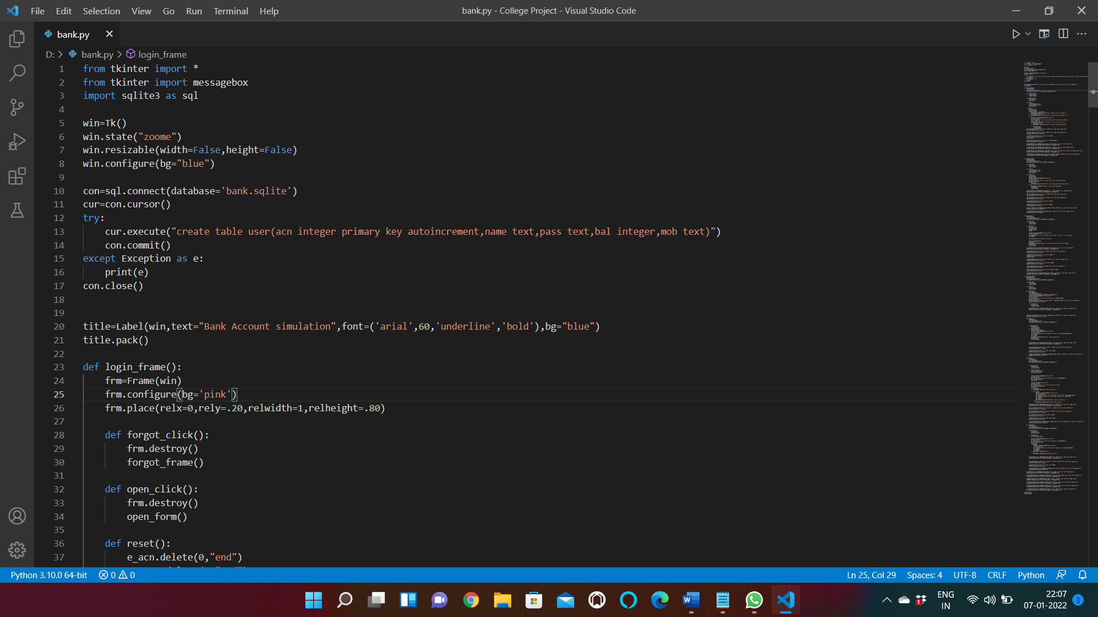

Slide 10
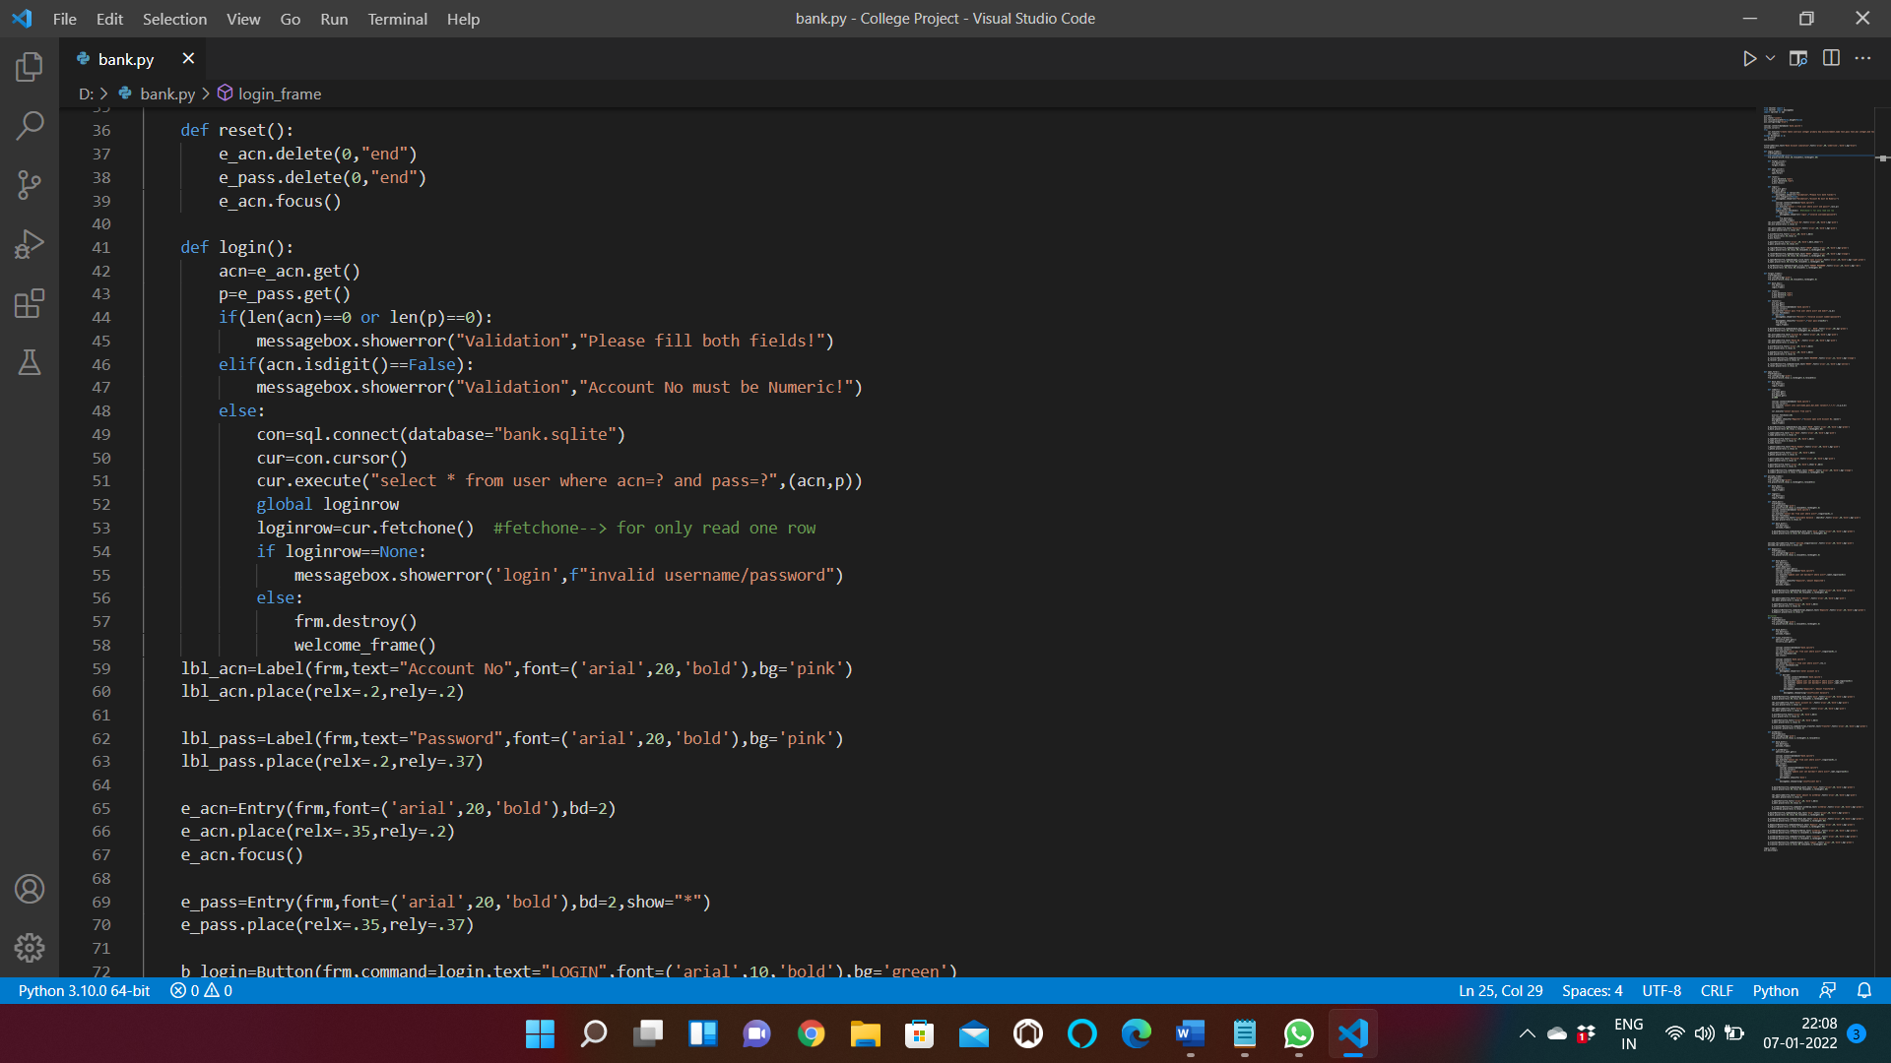

Slide 11

Proposed project is beneficial only if it can be turned into information systems that will meet the organizations operating requirements. Simply stated, this test of feasibility asks if the system will work when it is developed and installed. Are there major barriers to Implementation? Here are questions that will help test the operational feasibility of a project:Is there sufficient support for the project from management from users? If the current system is well liked and used to the extent that persons will not be able to see reasons for change, there may be resistance.
Are the current business methods acceptable to the user? If they are not, Users may welcome a change that will bring about a more operational and useful systems.

Slide 12
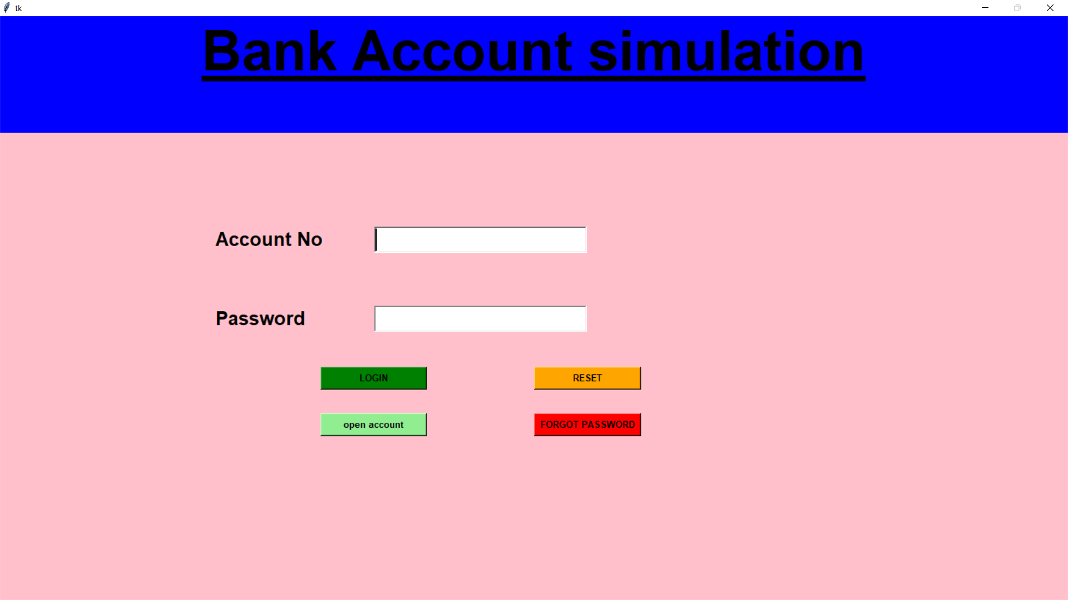

Slide 13
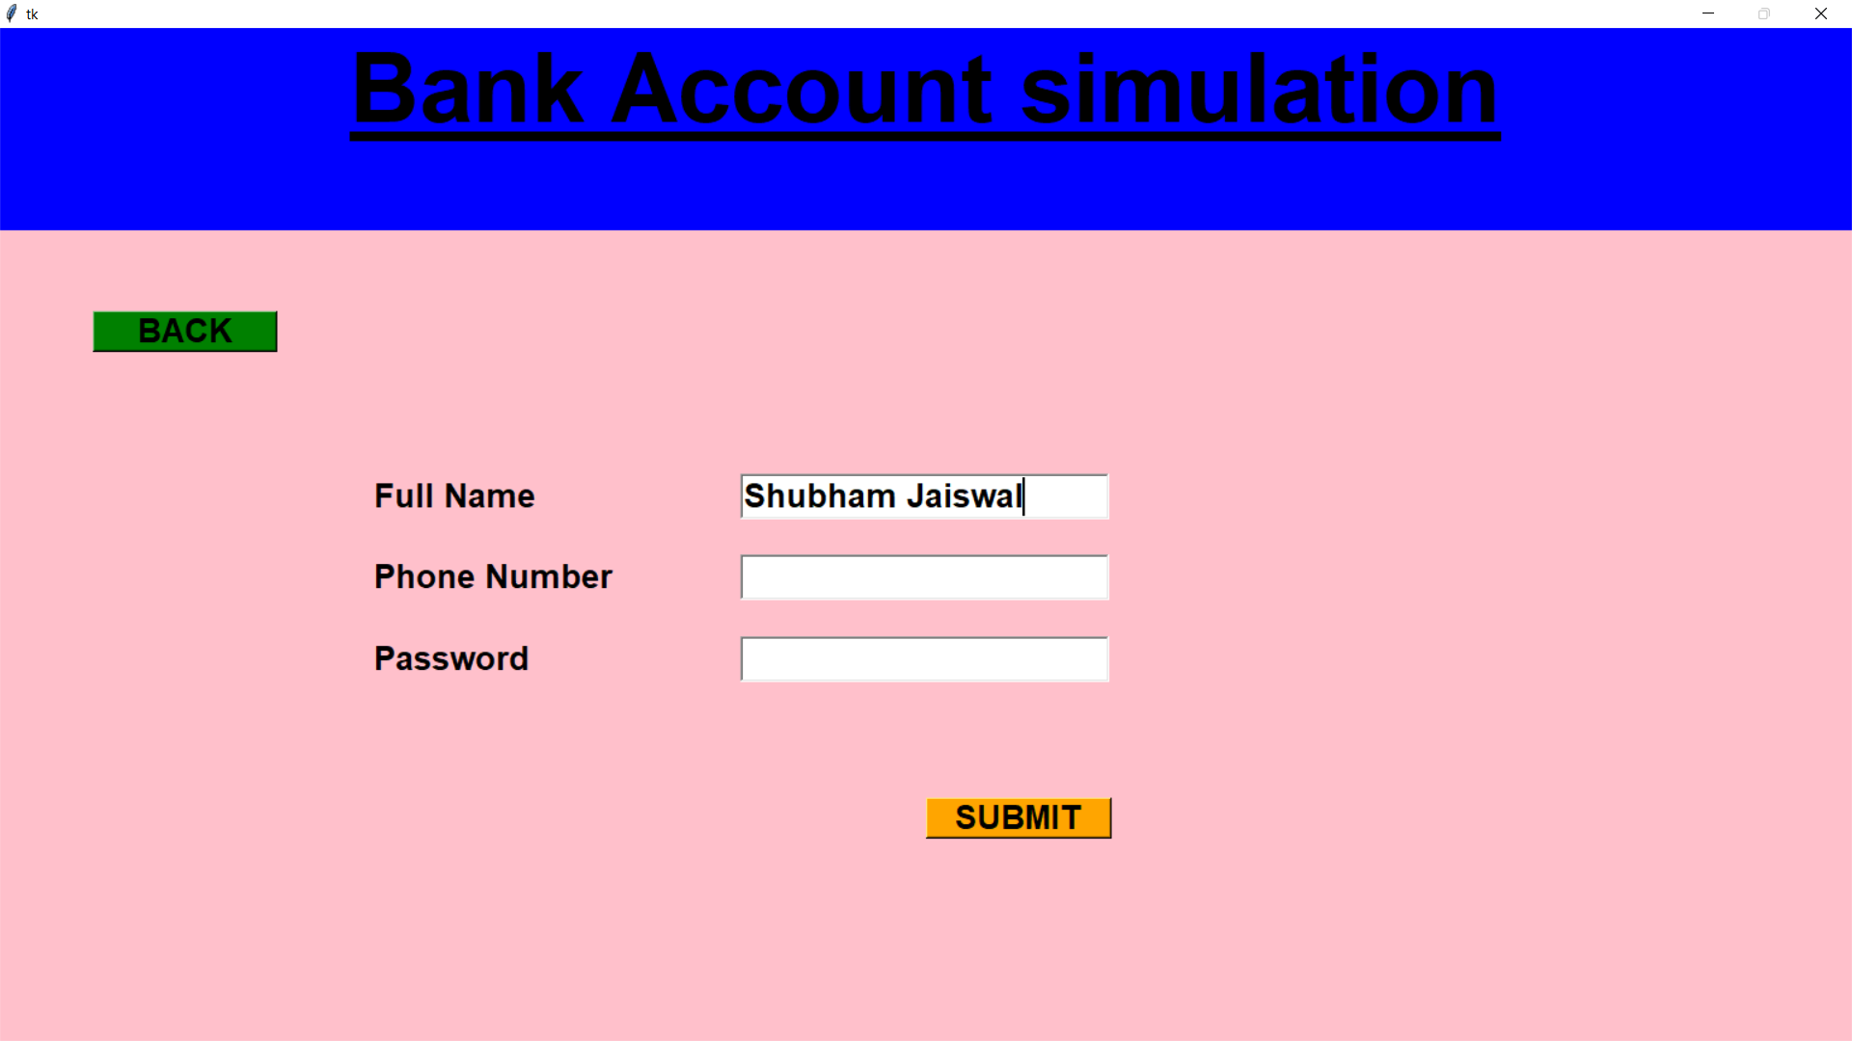

Slide 14
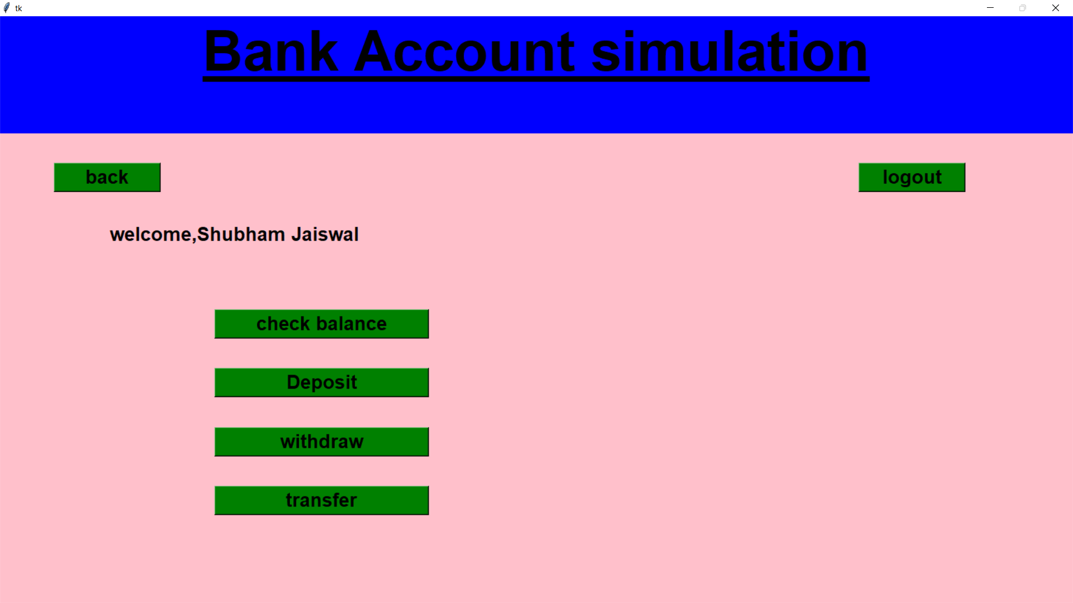

Slide 15
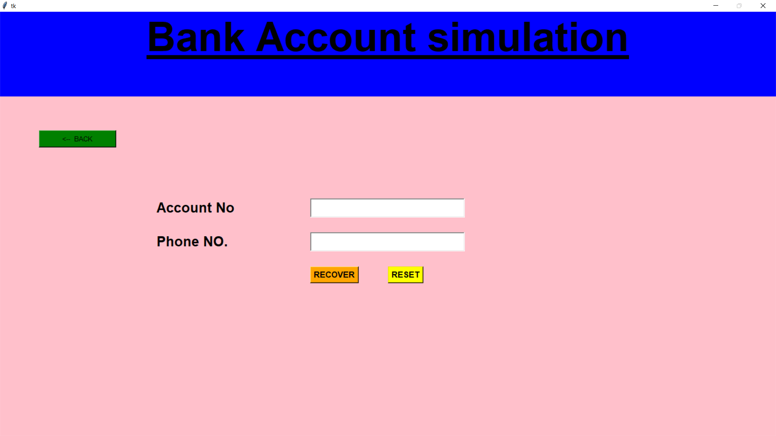

Slide 16
Have the user been involved in the planning and development of the project?
Early involvement reduces the chances of resistance to the system and in general and increases the likelihood of successful project.
Since the proposed system was to help reduce the hardships encountered. In the existing manual system, the new system was considered to be operational feasible.

Slide 17
System Requirement Specification
Overview:
Looking for an online comprehensive solution to manage internet banking. This will be accessible to all customers who have a valid user id and password. This system provides the following facilities………
Balance enquiry
Funds transfer to another account in the same bank
Request for cheque book

Slide 18
Modules Description
No of Modules:
The system after careful analysis has been identified to be presented with the following modules:
The Modules involved are
Administrator.
Customer.
Transaction.
Security and authentication.
Reports

Slide 19
Reports Module
Description for Modules:
Administrator:
Administrator can add the customers (users) and provides some username and password for the customer. Administrator can accept the cheque book requests, view all the transactions and provide loans information and branch details.
Customer:
User can make a funds transfer to another account in the same bank. User is provided with a transaction password which is different from the login password. User applies the cheque book requests; view all the loan information, sub branch details.

Slide 20
Transaction:
User can transfer funds from his account to any other account with this bank. If the transaction is successful a notification should appear to the customer, in case it is unsuccessful, and a proper message should be given to the customer why it failed.
Security and authentication:-
User Open Account
Login as a user or administrator
Reset password
Forgot password

Slide 21
Reports:-
In this module the different actors can generate the different types of reports according to their access.

Slide 22
SOFTWARE REQUIREMENT
Operating System : Windows 7 or Linux
User Interface : GUI
Programming Language : Python
Applications : VS code
Database : SQL
Frame Work : Tkinter Library

Slide 23
HARDWARE REQUIREMENT
Processor : i3 intel+
Hard Disk : 256GB
RAM : 2GB or more

